Slide 1
Exponential Distribution

Slide 2
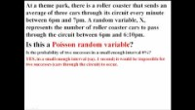
Revisiting Poisson Process
https://www.youtube.com/watch?v=PdX2LBJgzN8

Slide 3
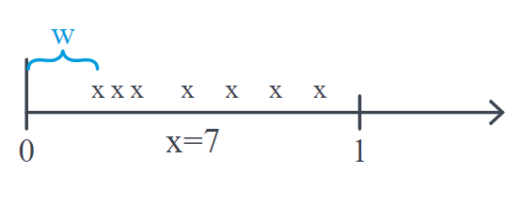
Exponential Distribution
Suppose X, following an Poisson process, equals the number of customers arriving at a bank in an interval of length 1.
If λ, the mean number of customers arriving in an interval of length 1, is 6, say, then we might observe something like this:
In this particular representation, seven (7) customers arrived in the unit interval.
Previously, our focus would have been on the discrete random variable X, the number of customers arriving.
As the picture suggests, however, we could alternatively be interested in the continuous random variable W, the
waiting time until the first customer arrives.
Let's push this a bit further to see if we can find F(w), the cumulative distribution function of W:

Slide 4
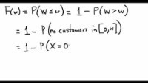
Exponential Distribution
https://youtu.be/awo6q8IDKX4

Slide 5


Exponential Distribution
Now, to find the probability density function f(w), all we need to do is differentiate F(w). Doing so, we get:
for 0<w<∞.
Typically, though we "reparameterize" before defining the "official" probability density function.
If λ (the Greek letter "lambda") equals the mean number of events in an interval, and θ (the Greek letter "theta")
equals the mean waiting time until the first customer arrives, then:
For example, suppose the mean number of customers to arrive at a bank in a 1-hour interval is 10. Then, the average (waiting) time until the first customer is 110 of an hour, or 6 minutes.

Slide 6


Exponential Distribution
The continuous random variable X follows an exponential distribution if its probability density function is:
Examples
•The life time of an electronic device.
•The time between arrivals of two successive buses.
•The duration time of a car service.
•Time until next earthquake occurs.

Slide 7




Properties of Exponential Distribution
1. The moment generating function of an exponential random variable X with parameter θ is:
2. The mean of an exponential random variable X with parameter θ is:
3. The variance of an exponential random variable X with parameter θ is:

Slide 8

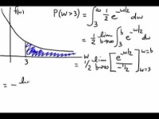
Example 1
Students arrive at a local bar and restaurant according to an approximate Poisson process at a mean rate of 30 students per hour. What is the probability that the bouncer has to wait more than 3 minutes to card the next student?
Solution
If we let X equal the number of students, then the Poisson mean λ is 30 students per 60 minutes, or 1/2 student per
minute! Now, if we let W denote the (waiting) time between students, we can expect that there would be,
on average, θ=1/λ=2 minutes between arriving students. Because W is (assumed to be) exponentially distributed
with mean θ=2, its probability density function is:
for w≥0.
Now, we just need to find the area under the curve, and greater than 3, to find the desired probability:
https://youtu.be/9Sj8nSQhvpY

Slide 9
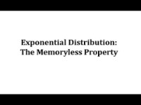
Example 2
https://www.youtube.com/watch?v=tXHhn6gb_X8

Slide 10

Example 3
The number of miles that a particular car can run before its battery wears out is exponentially distributed with an average of 10,000 miles. The owner of the car needs to take a 5000-mile trip. What is the probability that he will be able to complete the trip without having to replace the car battery?
Solution
At first glance, it might seem that a vital piece of information is missing. It seems that we should need to know how many miles the battery in question already has on it before we can answer the question! Hmmm.... or do we? Well, let's let X denote the number of miles that the car can run before its battery wears out. Now, suppose the following is true:
If it is true, it would tell us that the probability that the car battery wears out in more than y=5000 miles doesn't matter if the car battery was already running for x=0 miles or x=1000 miles or x=15000 miles.
Now, we are given that X is exponentially distributed. It turns out that the above statement is true for the exponential distribution.It is for this reason that we say that the exponential distribution is "memoryless."

Slide 11


Example 3
It can also be shown that if X is exponentially distributed with mean θ, then:
Therefore, the probability in question is simply:
We'll leave it to the gentleman in question to decide whether that probability is large enough to give him
comfort that he won't be stranded somewhere along a remote desert highway!

